Slide 1
M11

Slide 2
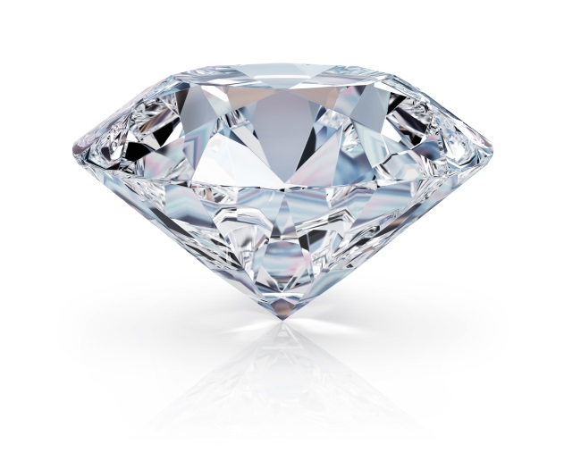
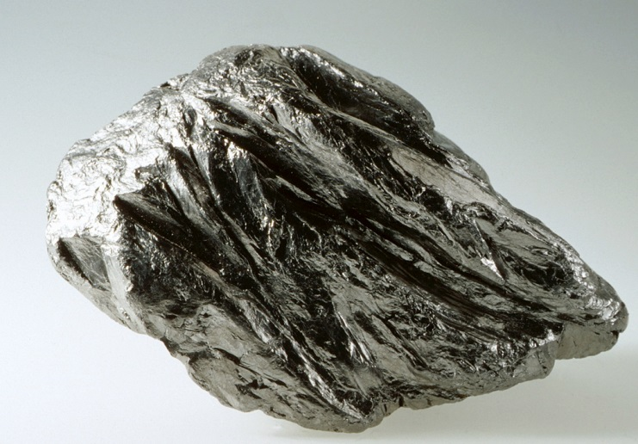
The carbon cycle
Carbon is found in various forms on the Earth.
It occurs in the elemental form as diamonds and graphite.

Slide 3

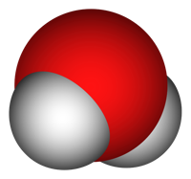
In the combined state, it is found as carbon dioxide in the atmosphere
Carbonate
Hydrogen carbonate salts
In various minerals
C
o
o

Slide 4
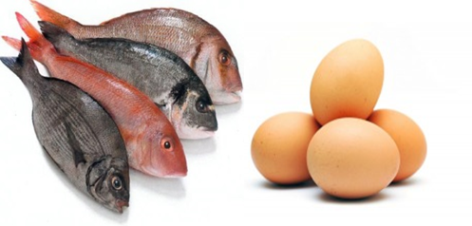
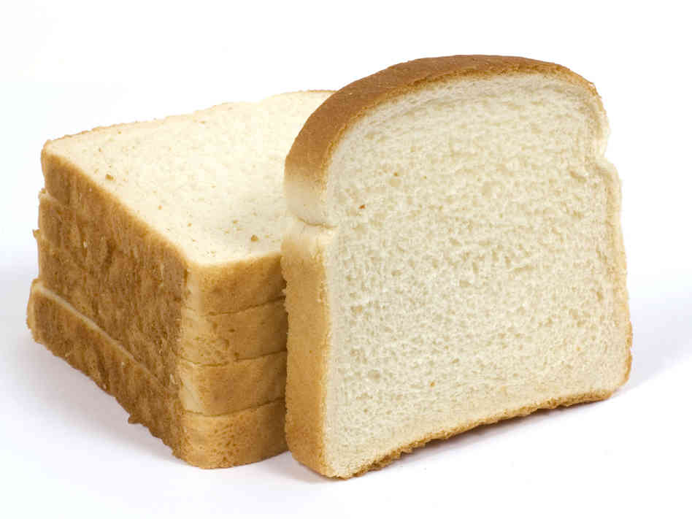
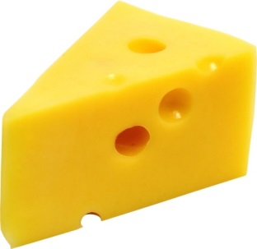
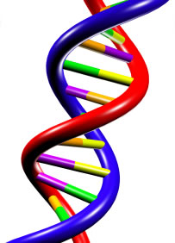

The carbon cycle
All life-forms are based on carbon-containing molecules like proteins, carbohydrates, fats, nucleic acids, vitamins.
Proteins
Carbohydrates
Fats
Nucleic acids
DNA and RNA
Vitamins

Slide 5


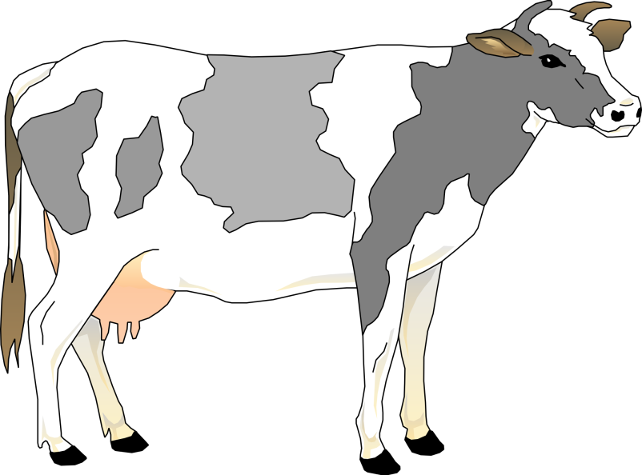


Carbon enters the plants in the form of carbon dioxide through photosynthesis in the presence of sunlight
SUN
In the body of plants carbon dioxide is converted into glucose(carbohydrates)
CO₂
Carbohydrates
Photosynthesis

Slide 6

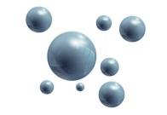
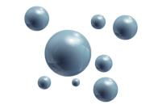
When the plants are eaten by animals carbohydrates enters the body of animals.
During respiration carbohydrates are broken down to produce energy and carbon dioxide is released back into the atmosphere.
Respiration
CO₂

Slide 7
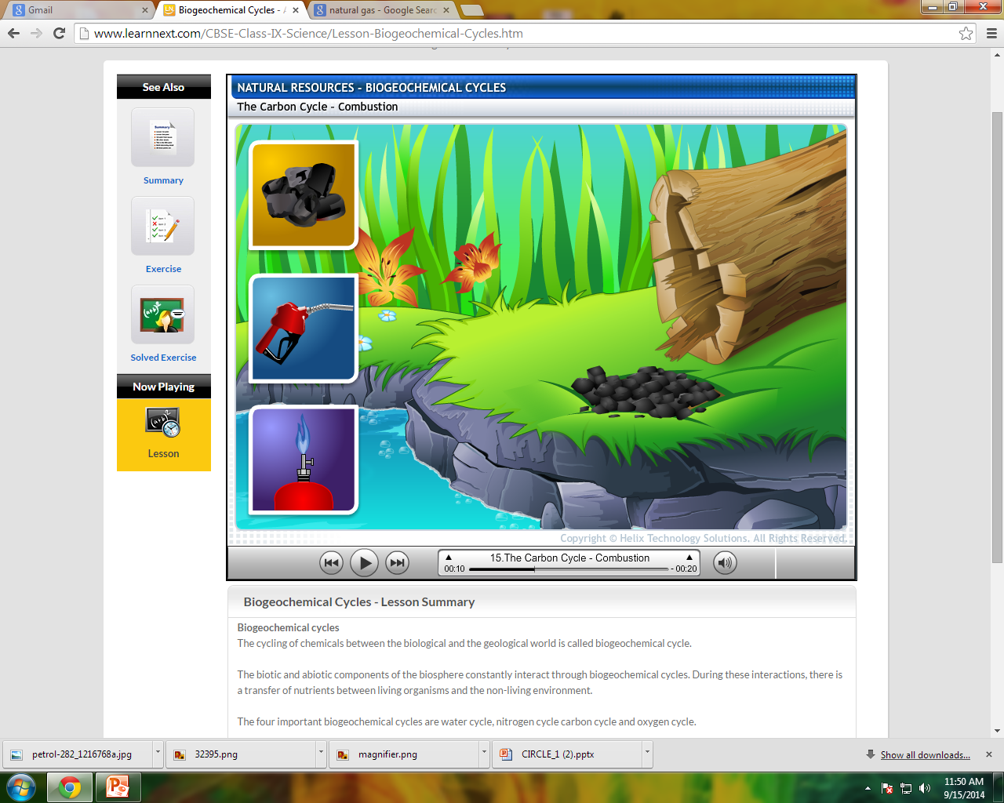
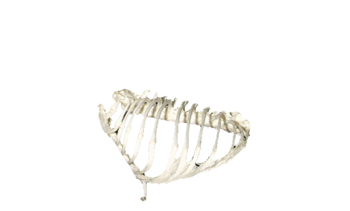
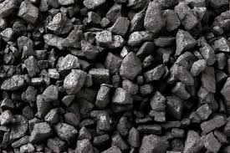



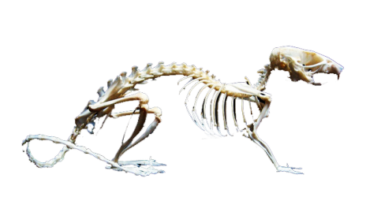



When these fossils fuels are burnt for heating , cooking , transportation and industrial processes carbon dioxide is released into atmosphere.
When plants and animals die, they are decomposed by bacteria and fungi and carbon dioxide is released in atmosphere.
Also, dead plants and animals in the soil are converted into fossils fuels like coal, petroleum and natural gas.
Fossils fuel
Decomposition
C
C
C
C
o
o
o
o
o
o
o
o

Slide 8
Carbon, is thus cycled repeatedly through different forms by various physical and biological activities.
SUN
CO₂
CO₂
CO₂
CO₂

